Slide 1









Big Data Analytics Project:
Property Based Crime Analysis (2001_2010)
name : S.Monis
Roll no : 2211CS010502

Slide 2

Introduction
Property crime is a major concern that affects public safety and economic stability across India. To address this issue, our project leverages Big Data Analytics using PySpark to study property crime trends over a decade (2001–2010). The system processes large-scale crime datasets to uncover meaningful insights about regional crime patterns, recovery efficiency, and changes in crime behavior over time. By using a data-driven approach, this project demonstrates how big data technologies can transform raw crime records into actionable intelligence for decision-makers and law enforcement agencies.

Slide 3
Project Objective
Analyze crime patterns to identify dominant crime types.
Evaluate law enforcement efficiency through recovery rates.
Identify high-risk and high-recovery regions across India

Slide 4

Data & Technology Stack
Dataset & Scope
Dataset: 10_Property_stolen_and_recovered.csv
Scope: 35 Indian regions
Period: 10 years (2001–2010)
Records: 2,449 total entries
This comprehensive dataset provides a robust foundation for our analysis, covering a wide geographic and temporal range.
Technology Stack
1.PySpark
Distributed computing for large-scale data processing.
2.Jupyter
Interactive environment for development and visualization.

Slide 5
Methology
Data Cleaning & Preprocessing
Schema Check
Data was loaded with appropriate data types:
Area: String
Group_Name: String
Cases_Stolen: Long Integer
Value_Stolen: Long Integer
Year: Integer
...and other relevant columns
Ensuring correct data types is fundamental for accurate analysis and prevents computational errors.
Data Quality Assessment:
Zero Defects
A critical finding during preprocessing was the exceptional quality of our dataset. We confirmed 100% data quality with:
Zero Missing Values: All fields were populated.
Zero Duplicate Rows: Each record was unique.
This high data integrity significantly simplified our cleaning pipeline, allowing us to focus directly on feature engineering and analysis.

Slide 6
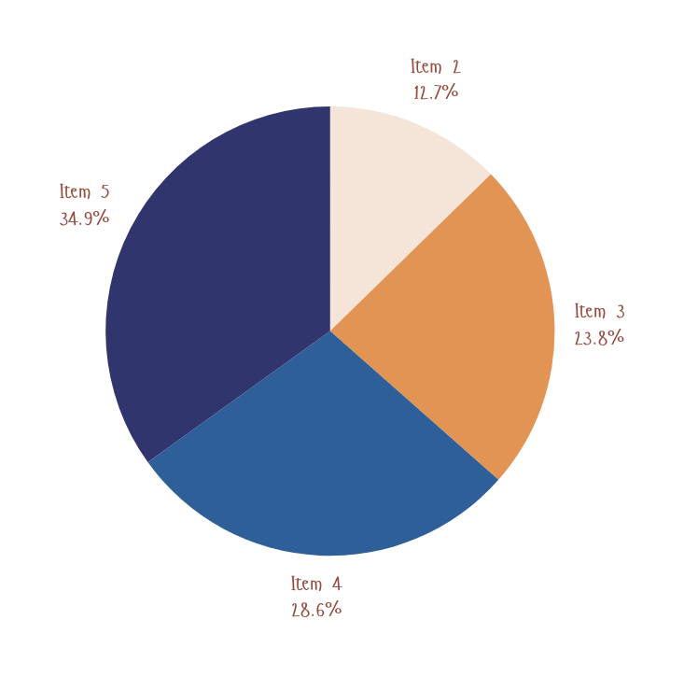
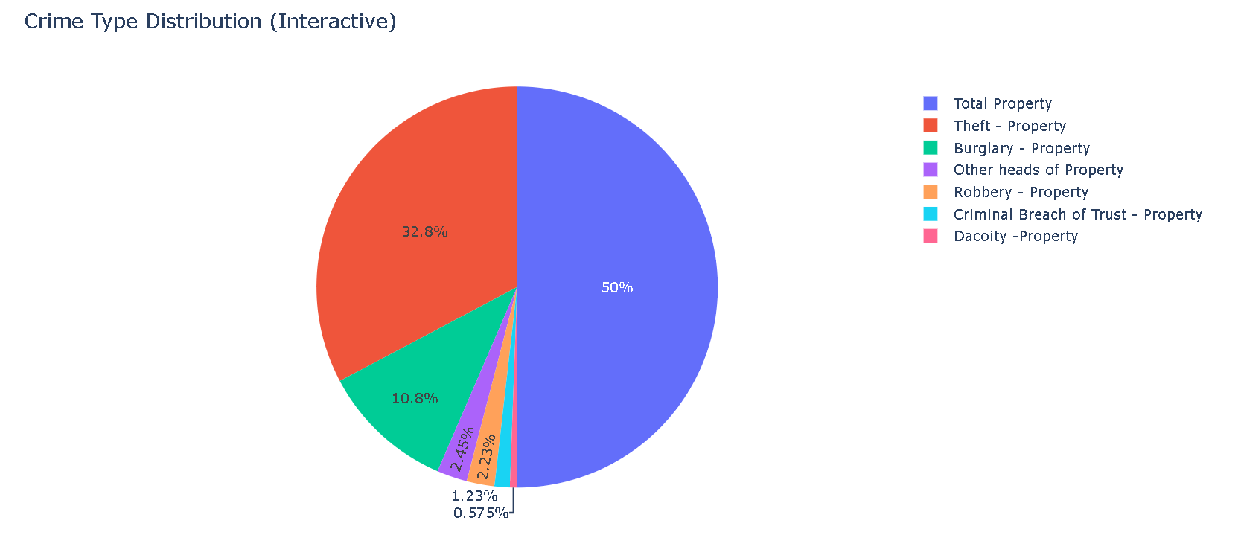
Key Finding 1: Crime Type Dominance
Theft is the Primary Concern
Our analysis unequivocally reveals that Theft - Property is the dominant specific crime head within the dataset, accounting for the vast majority of all property-related incidents.
Theft: 32.8% of all property crimes
Burglary: 10.8%
This insight is critical for policymakers to prioritize preventative measures and allocate resources effectively toward mitigating theft

Slide 7
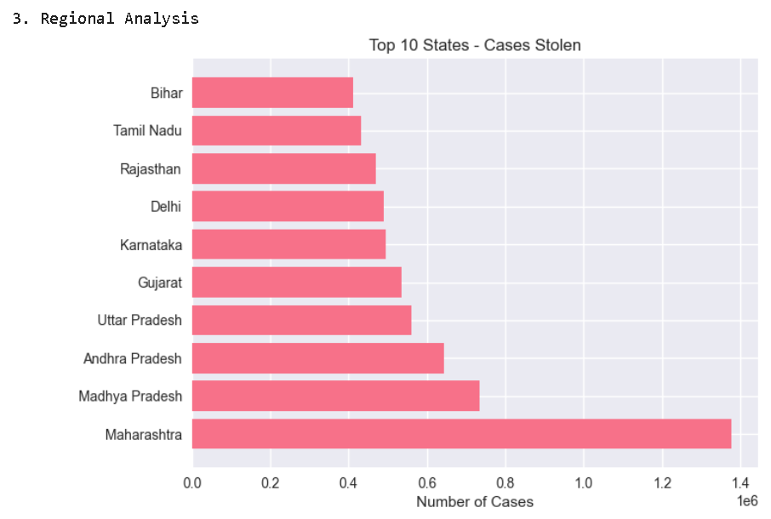
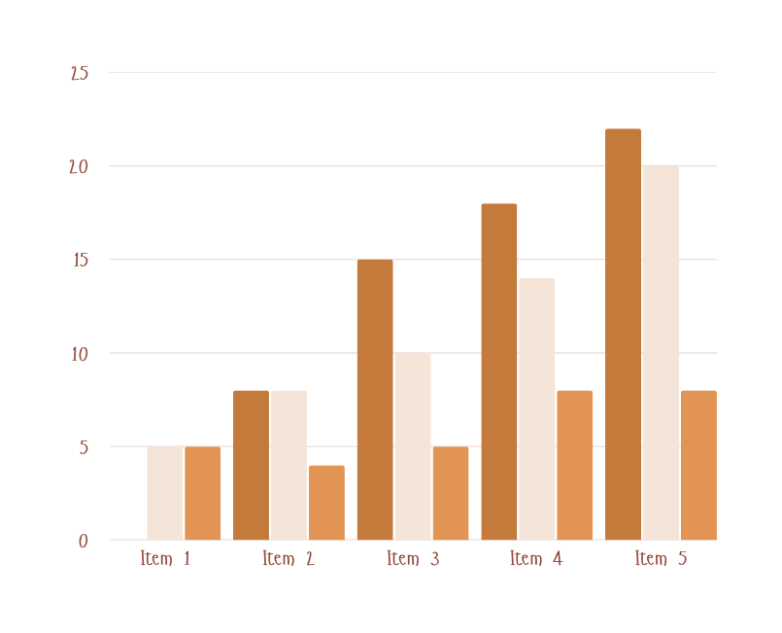
Key Finding 2. Top and Bottom Crime-Prone Regions
Understanding geographical impact is crucial. This chart illustrates the regions with the highest and lowest total stolen cases, highlighting areas that require focused attention and intervention.
As per our aggregation,Maharashtra, Madhya pradesh and Andhra Pradesh consistently report the highest number of stolen property cases. Conversely, regions like Tamilnadu and Bihar show significantly lower rates, which might indicate better security or different reporting practices.

Slide 8
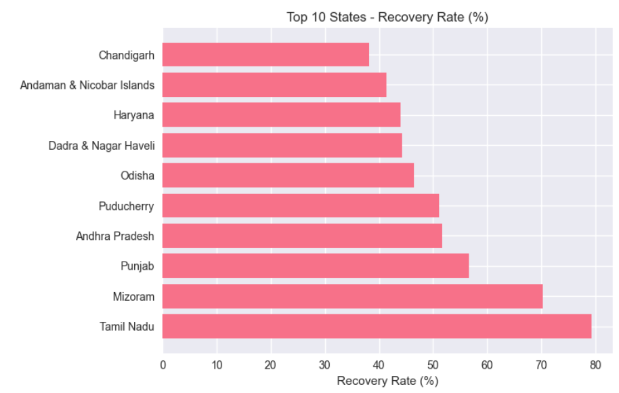

Key Finding 3: Recovery Efficiency by Region
Where is High-Value Property Recovered?
This chart compares regions based on their Recovery Rate (Value), revealing where high-value property is most and least likely to be retrieved. This offers a nuanced view of law enforcement performance beyond just crime rates.
Top Performers: Tamilnadu, Mizoram, and Punjab demonstrate higher efficiency in recovering stolen property by value.
Areas for Improvement: HimachaLpradesh, Daman & Diu, and West Bengal show lower recovery rates, indicating potential challenges in their investigative or recovery processes.

Slide 9
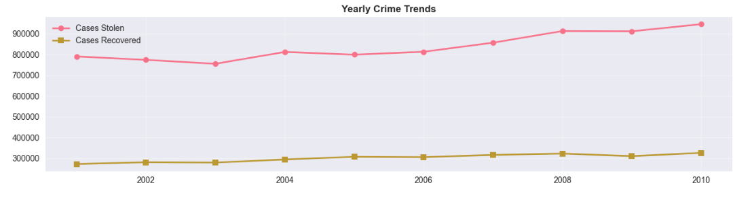
Key Finding 4: Decadal Property Crime Trends (2001–2010)
While crime fluctuated, the decade ended with significantly more stolen property cases than it began, indicating a failure to curb the issue.The early 2000s showed initial success, with the number of cases slightly dropping for two consecutive years.This suggests that the crime wave accelerated in the mid-2000s. We see a significant spike in 2004, and the highest volume of property crime was reported at the end of our study period in 2010.

Slide 10

Conclusion
This project proves that Big Data tools like PySpark are essential for crime analysis. They allow us to move beyond simple counts and create complex efficiency metrics rapidlyThe data shows the problem is getting worse, not better. The significant increase in stolen property cases demands an immediate data-driven response.The next step is to leverage this clean data for predictive modeling. We can move from analyzing the past to predicting the future to truly enhance public safety.

Slide 11
Thank You

